Slide 1

A PRACTICAL VISUAL GUIDE
Yield Management in the Hotel Industry
How Smart Hotels Maximize Revenue Without Adding More Rooms
For hotel owners, general managers, and revenue managers

Slide 2
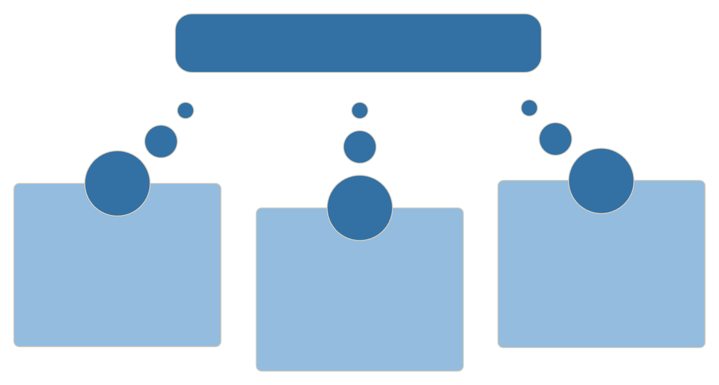


CORE PRINCIPLE
The Core Principle of Yield Management
Hotels don't earn more by selling more rooms.
They earn more by selling the right room, to the right guest, at the right price, at the right time.
Dynamic Pricing
Fixed inventory
Changing demand
Dynamic pricing decisions
The underlying constraint.
The core process of adjusting prices.
A key variable influencing adjustments.
Perishable Assets
Demand Shifts Daily
Prices Must Follow
Every unsold night is lost forever — it cannot be recovered.
Demand changes every day based on events, seasons, and competition.
Pricing should flex dynamically in response to demand signals.

Slide 3






DECISION FLOW
How Revenue Managers Make Yield Management Decisions
Booking Pace
Demand Forecast
Are bookings faster or slower than expected?
What is demand likely to be?
Occupancy Level
Pricing Decision
How many rooms remain available?
Increase, maintain, or reduce rates.
Inventory Control
Revenue Outcome
Open or restrict room availability.
Maximize revenue per available room.

Slide 4



PRICING COMPARISON
One Hotel: Two Pricing Approaches
Traditional Pricing
Yield Management
Fixed rate: $220 for every night
Same price for every guest
Rooms sell early at flat rate
Limited revenue opportunity
Start at $220 — early demand window
Increase to $300 as occupancy rises
Increase again to $360 near sell-out
Premium pricing protects peak revenue
Revenue stays flat.
Same rooms. Higher revenue.
The inventory didn't change. The pricing strategy did.

Slide 5




DEMAND LEVERS
What Hotels Adjust During High Demand
Price
Length of Stay
Raise rates to capture maximum revenue per room.
Apply minimum stay rules to protect high-value nights.
Distribution
Availability
Close low-value channels and third-party discounts.
Protect premium inventory for the highest-value bookings.
The best revenue outcomes come from combining pricing, inventory, and distribution decisions, not changing room rates alone.

Slide 6






DEMAND TRIGGERS
Common Triggers That Change Hotel Pricing
Conference
Festival
Weekend
↑ Increase rates — business demand spikes around major conventions.
↑ Increase rates — leisure demand surges during local events.
Adjust dynamically — weekend patterns vary by market and season.
Low Occupancy
Last-Minute Demand
Early Booking Pace
Offer promotions — stimulate demand with targeted rate incentives.
Increase pricing — scarcity justifies premium last-minute rates.
Monitor booking pace and optimise pricing— fast pace signals strong demand ahead.
Revenue managers respond to demand signals — not fixed calendars.

Slide 7

KEY TAKEAWAYS
Five Principles Every Revenue Manager Knows
1
2
3
Rooms are perishable assets.
Occupancy alone doesn't maximize revenue.
Demand should determine pricing.
An unsold room night is lost revenue that can never be recovered.
Fixed-rate strategies leave money on the table during peak periods.
A full hotel at the wrong price underperforms a hotel with smart pricing.
4
5
Inventory controls are as important as pricing.
Small pricing decisions compound into significant revenue gains.
Restricting availability protects revenue just as effectively as raising rates.
Consistent yield discipline across 365 nights drives meaningful annual growth.
Ready to Apply Yield Management at Your Hotel?
Book a free demo today to see how AxisRooms helps hotels combine pricing, inventory, distribution, and demand insights to maximize revenue from every available room.

